Slide 1
Be Witnessing
Acts
Dr. Rick Griffith • Crossroads International Church Singapore
BibleStudyDownloads.org

Slide 2
The Book of Acts in 3 Minutes (TheChurchatBrookHills.mp4)
131e

Slide 3
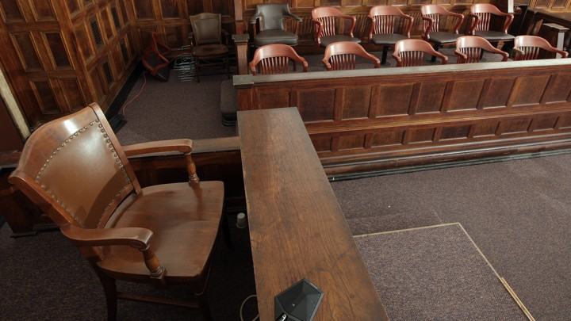
The Witness Stand
Notes:
It’s not hard to witness to what you have seen—

Slide 4
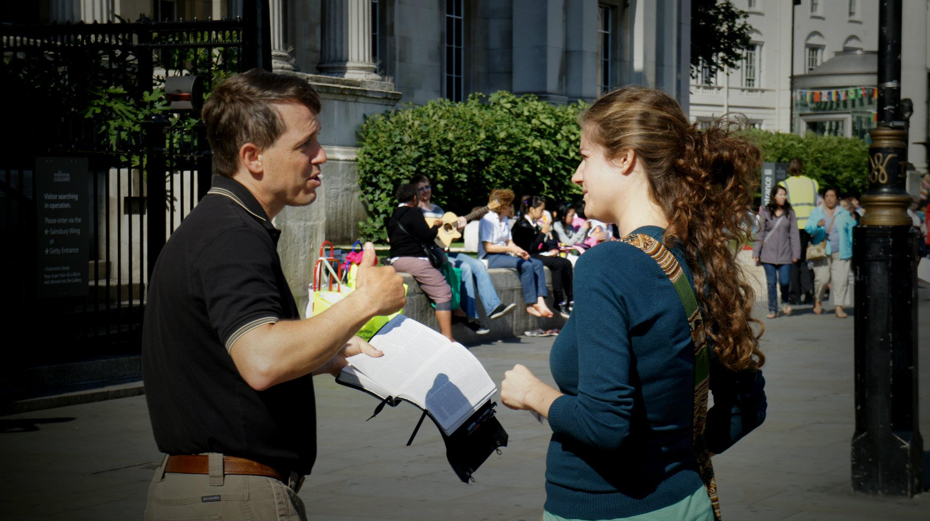
Is this you?
Notes:
—yet we often don’t feel that way about witnessing for Jesus.

Slide 5
Many Fear Evangelism!
Q65
Q74
Q83
"When I was a kid, I would go up to someone's porch, ring the doorbell, and run like the dickens. I still do it, except now our church calls it 'outreach training.'"
Notes:
—or is this you instead?

Slide 6
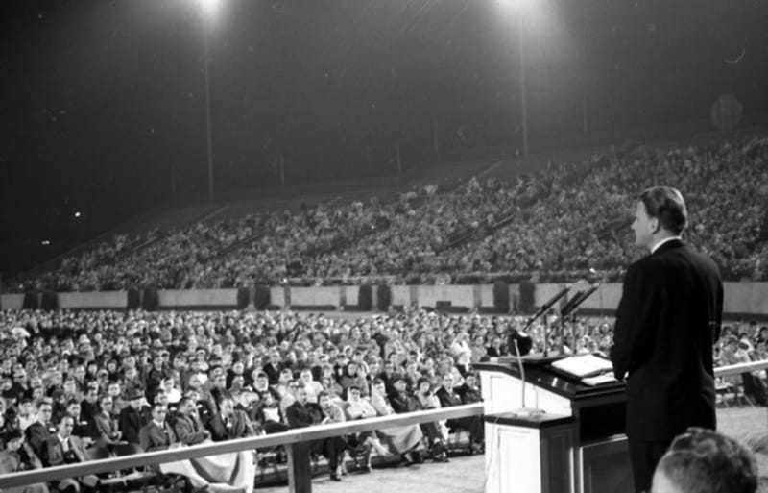
Billy Graham
Notes:
Some of us fear witnessing because we think we have to be a Billy Graham!

Slide 7
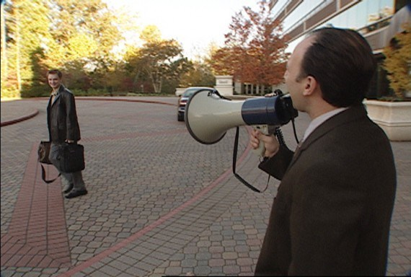
There are ineffective ways to witness.
Notes:
Others think of ineffective ways to witness.

Slide 8
Is this your cup?
Notes:
How are you doing at witnessing to what Jesus has done in your life?

Slide 9
Key Verse of Acts
"But you will receive power when the Holy Spirit comes on you; and you will be my witnesses in Jerusalem, and in all Judea and Samaria, and to the ends of the earth" (Acts 1:8).

Slide 10
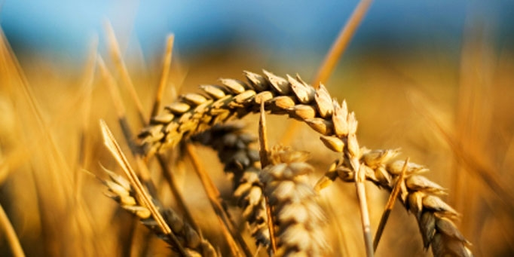
Why should we be witnessing?
Notes:
What reasons are there for you and I to seek a harvest?
Why is evangelism important?
Why missions?

Slide 11
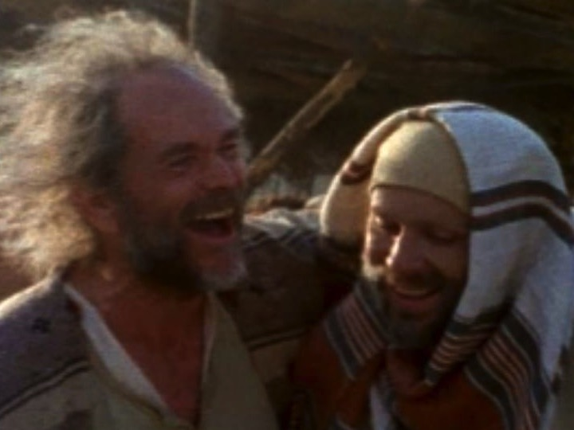
Who was Dr. Luke?
Medical doctor
Traveling companion of Paul
Articulate historian & writer
Notes:
Helping us understand how to be witnesses today is Dr Luke.

Slide 12
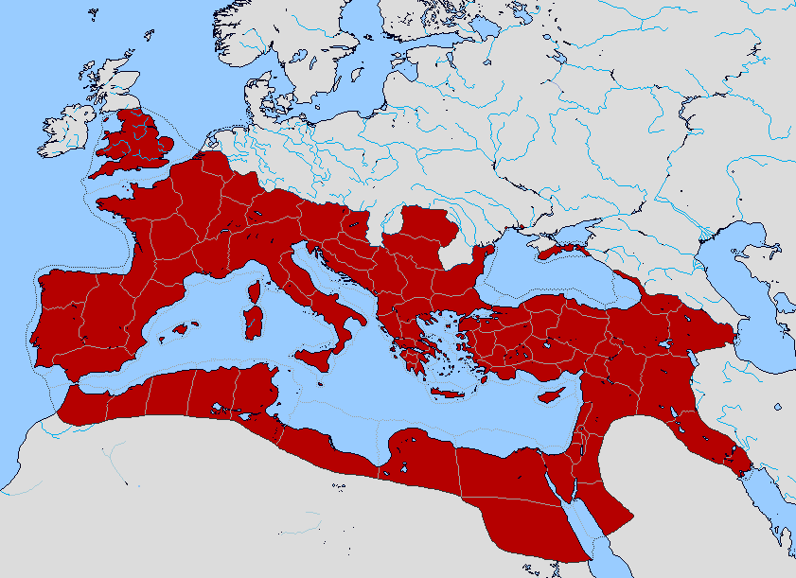
Bible Lands Blank Map
The Roman Empire
"But you shall receive power when the Holy Spirit has come upon you; and you shall be My witnesses both in Jerusalem, and in all Judea and Samaria, and even to the remotest part of the earth" (Acts 1:8 NAU).
"remotest part"
Samaria
Jerusalem
Judea
© https://www.deviantart.com/sharklord1/art/Alt-Roman-Empire-Provinces-701148110
Notes:
The gospel had reached half the Roman Empire, but how?
It was God’s work!

Slide 13
Why should we be witnessing?
3 reasons
Notes:
Today we’ll see three reasons we should witness for Jesus. Each is actually a stage of growth.
We will survey the entire book of Acts.
(So back to our question: Why should we witness?)

Slide 14
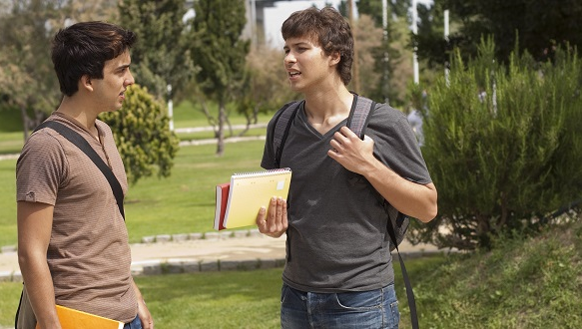
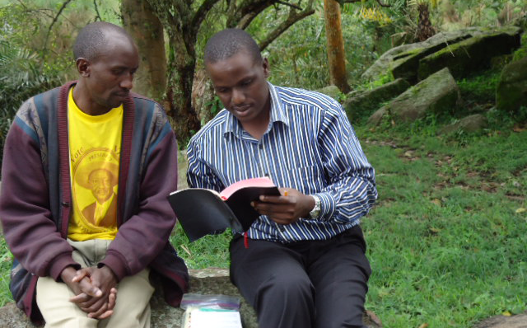
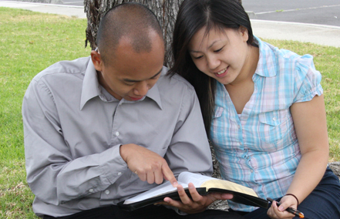
I. God has gone ahead of us so we can begin where we are (1:1–6:7).
Notes:
God helps us first tell others about Jesus where it is natural without crossing cultures.

Slide 15
God began the kingdom expansion in Jerusalem (Acts 1:1–6:7).
Notes:
God began the kingdom expansion in Jerusalem (1:1–6:7).

Slide 16
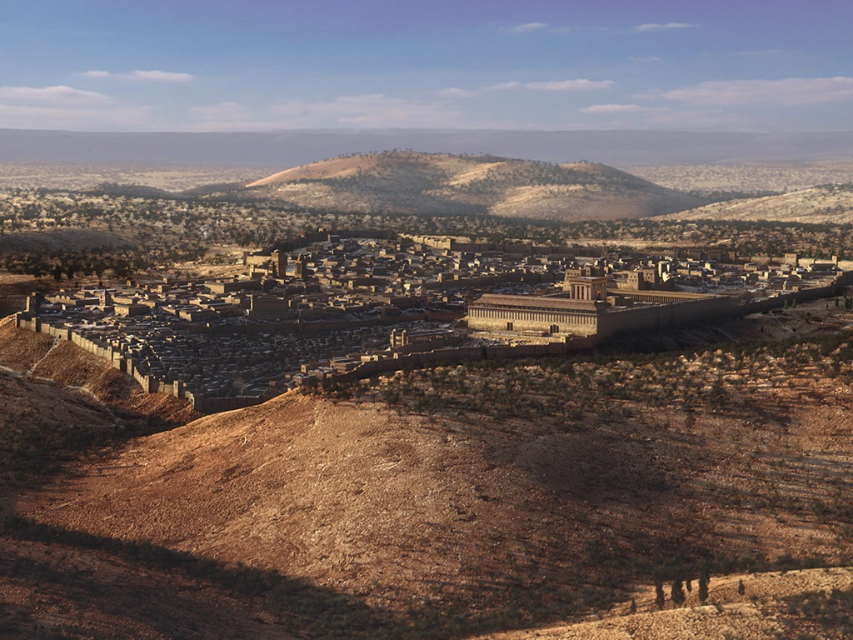
Jerusalem: God began the Church right at home for the first believers (Acts 1–2).
Notes:
God began the Church right at home for the first believers (Acts 1–2).

Slide 17
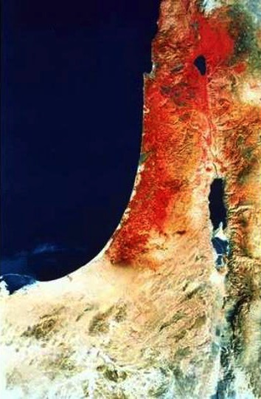
Acts 1:8 NAU
"remotest part"
"But you shall receive power when the Holy Spirit has come upon you; and you shall be My witnesses both in Jerusalem, and in all Judea and Samaria, and even to the remotest part of the earth."
Samaria
Jerusalem
Judea
Notes:
Jesus prepared Jews to first reach Jews (Acts 1).

Slide 18
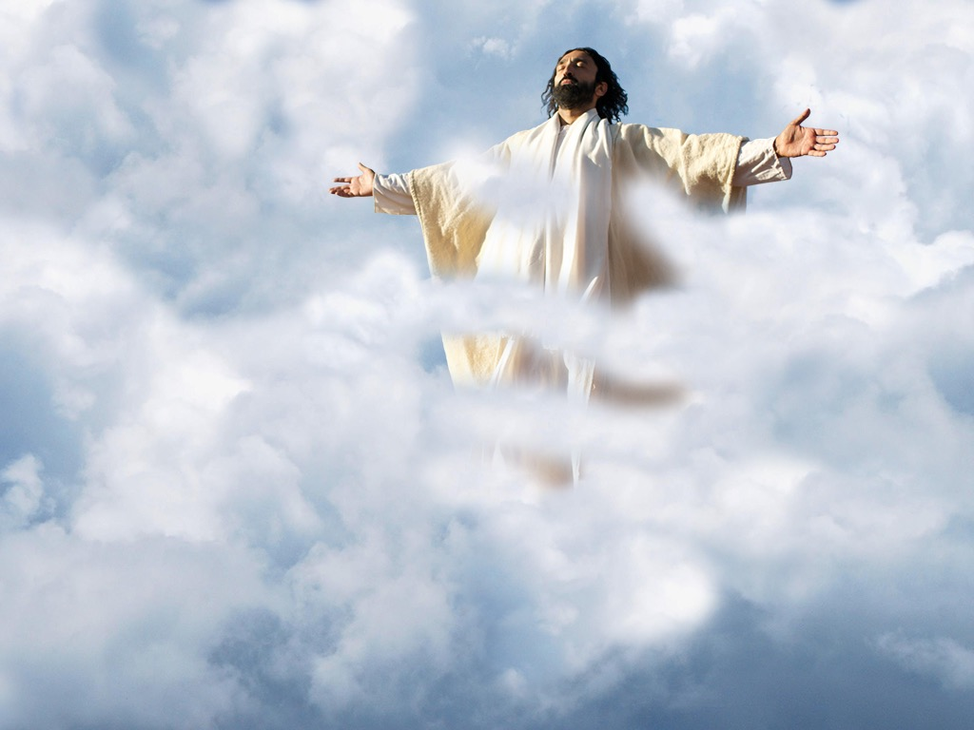
The Ascension
Notes:
Jesus told them to stay in Jerusalem until the Spirit came, then he left.

Slide 19
Used with permission

Slide 20
Slides on Acts 2
Notes:
The Spirit then gathered them to start the Church (Acts 2).

Slide 21
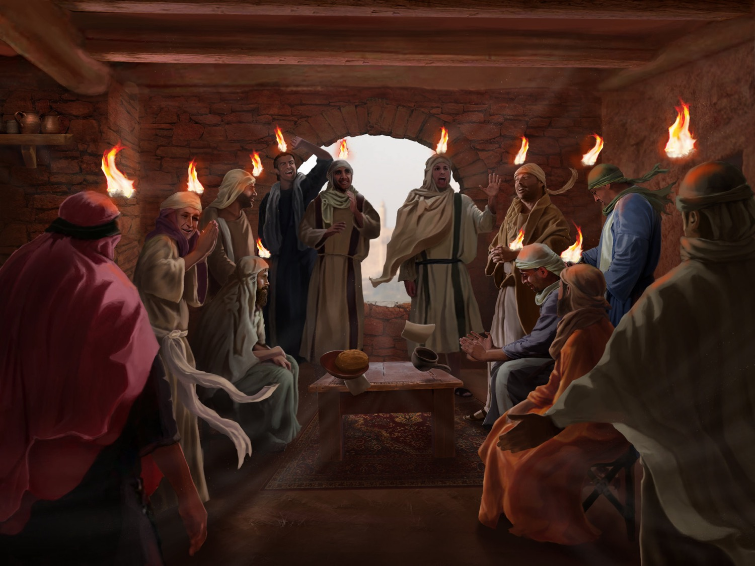
The Spirit Came at Pentecost (Acts 2)

Slide 22
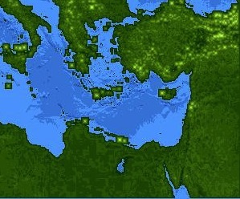
Jews at Pentecost––Acts 2:9-11
132
Rome (13)
PONTUS (7)
CAPPADOCIA (6)
ASIA (8)
PHRYGIA (9)
Parthia (1)
PAMPHILIA (10)
Mesopotamia (4)
CRETE (14)
Media (2)
Elam (3)
Jerusalem
CYRENE (12)
JUDEA (5)
ASIA––Roman Empire Provinces
Media––Parthian Empire Provinces
EGYPT (11)
Rome––Cities
CRETE––Islands
ARABIA (15)
Miles
0
200
400
600
800
1000
(1) (2) (3) etc. indicate sequence in Acts 2:9-11
Kms
0
300
600
900
1200
1500
Notes:
Jews numbered 40,000 in Rome during the reign of Augustus (30 BC to AD 14), so this was a sizable minority. We do not know for sure who actually started the church at Rome, but it likely was some of these Jews who returned to Rome after receiving the Spirit at Pentecost in Jeruslem. They, in turn, led Gentiles in Rome to faith as well.

Slide 23
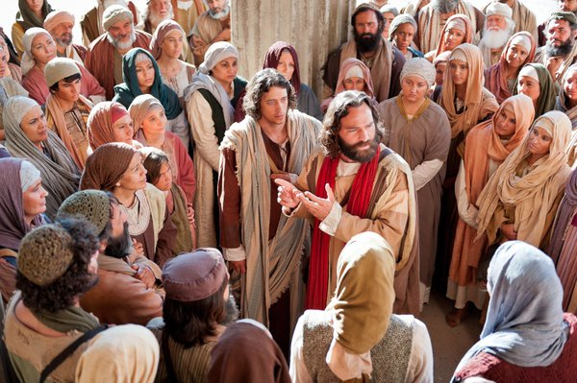
Peter Led 3000 to Christ at Pentecost
"Those who accepted his message were baptized, and about three thousand were added to their number that day."
Acts 2:41 NIV
Notes:
But it was Peter’s sermon that led 3000 to Christ that day.

Slide 24
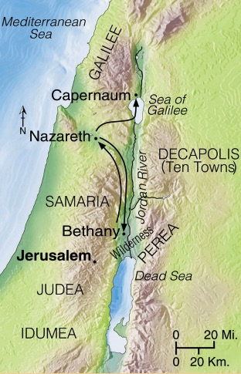
Progress Reports
125
End of the Earth
Key Verse: 1:8
2:47b
6:7
8:40
9:31
12:24
16:5
19:20
28:30-31
1:1–6:7
6:8–8:40
Acts 9–28
Why end this way?
Adapted from Stanley D. Toussaint, BKC; Jeremy Chew, EAST
Notes:
This began a series of 8 “progress reports” to show the expansion of this message through the book of Acts.

Slide 25
Slides on Acts 3
Notes:
The Jews witnessed near Jerusalem amidst opposition (3:1–6:7).

Slide 26
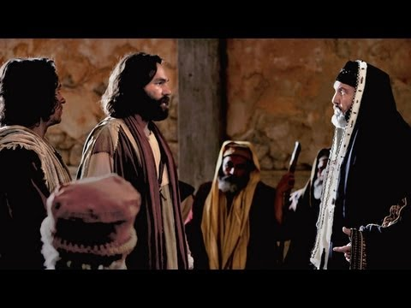
Peter & John Before the Sanhedrin
Acts 3 & 4

Slide 27
Slides on Acts 4

Slide 28
Joseph Called Barnabas Acts 4:36-37

Slide 29
Slides on Acts 5

Slide 30
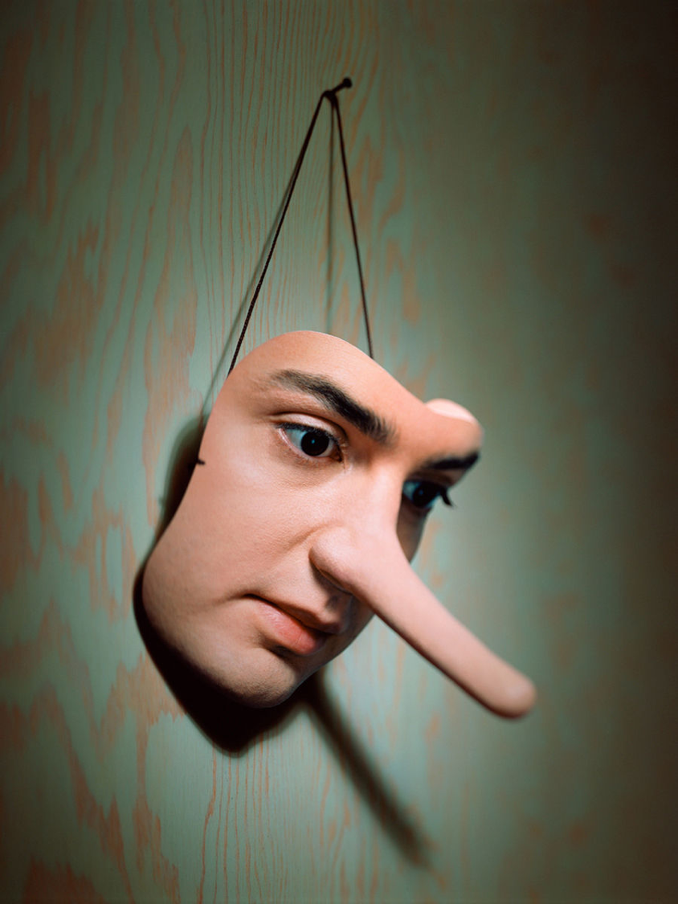
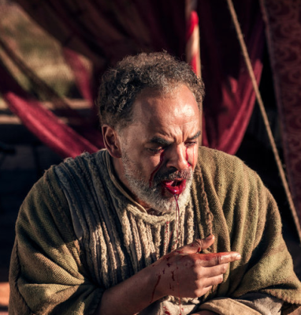
Ananias & Sapphira
Acts 5

Slide 31
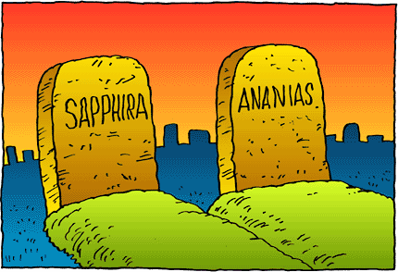
Grace, yes, but there is still divine discipline…

Slide 32
Slides on Acts 6

Slide 33
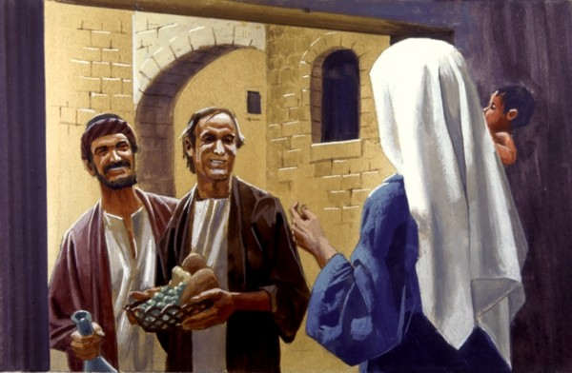
"The Seven"
Acts 6

Slide 34
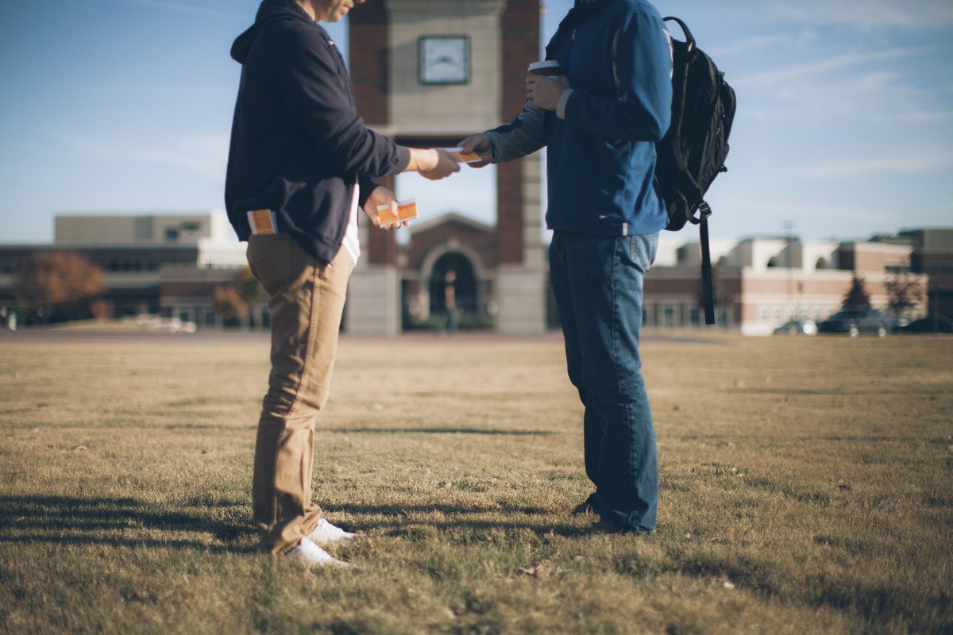
We need our witness to overflow first in our own setting
Notes:
I had to first be faithful in high school among my peers.
First allow the Spirit to lead you right where you live and work.

Slide 35
Why should we be witnessing?
3 reasons
Notes:
What reasons are there for you and I to seek a harvest?
Why is evangelism important?

Slide 36
I. God has gone ahead of us so we can begin where we are (1:1–6:7).
Notes:
God helps us first tell others about Jesus where it is natural without crossing cultures.

Slide 37
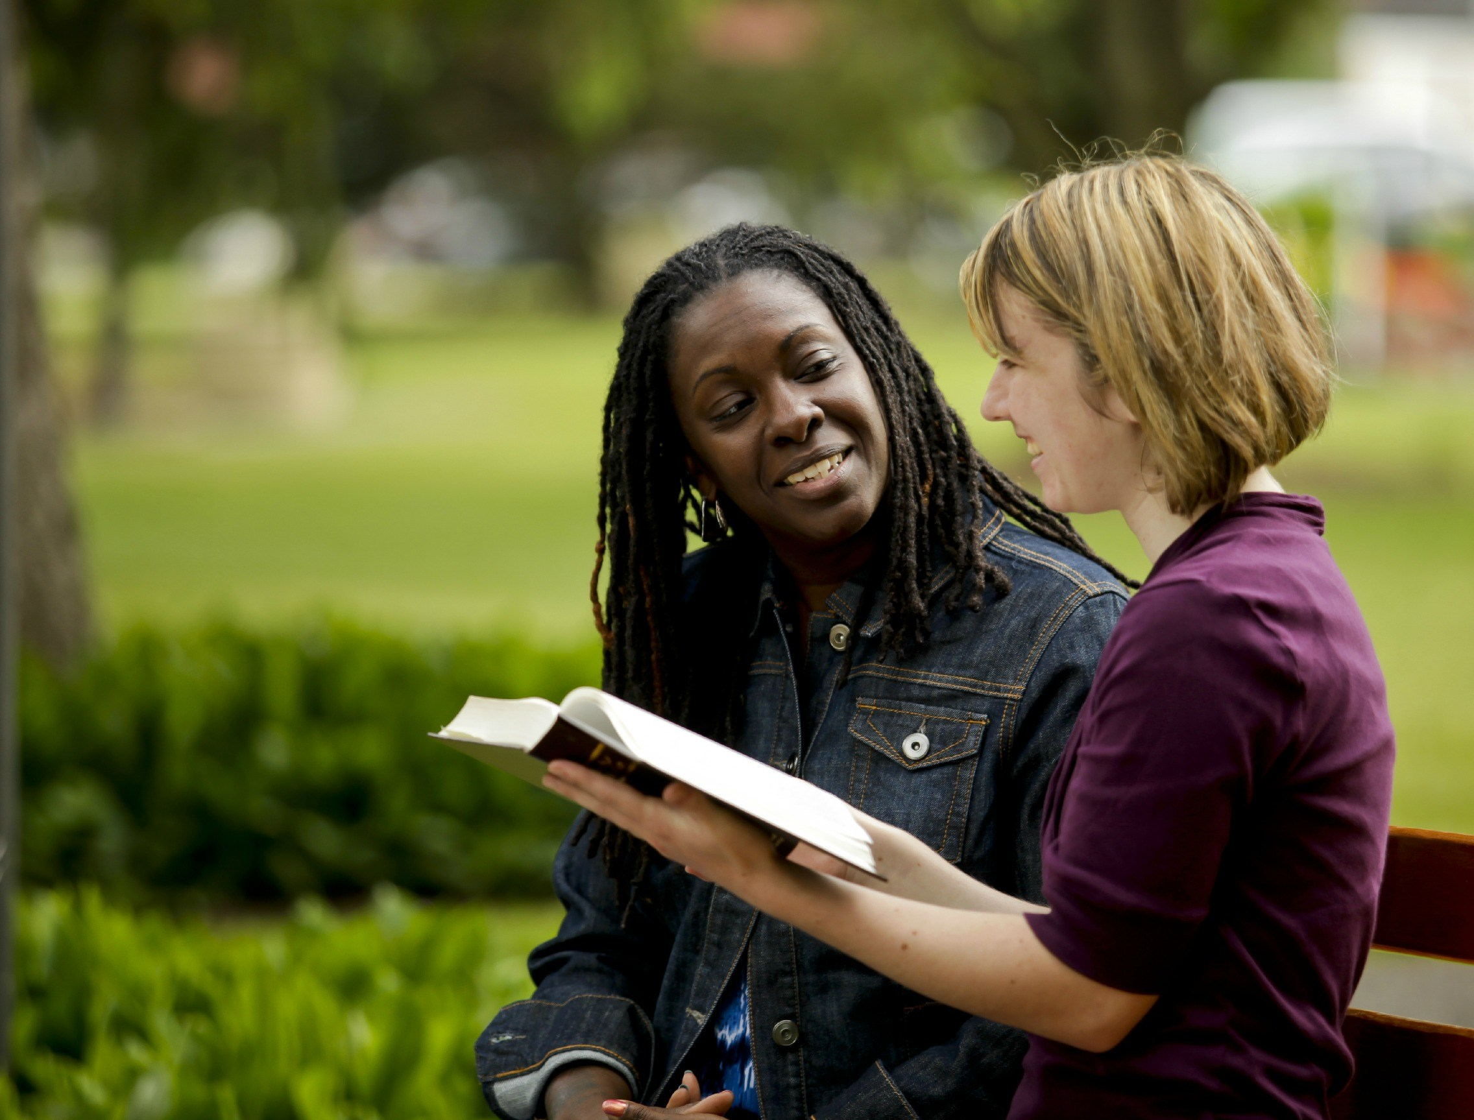
II. God gets the glory when we witness outside our comfort zone (6:8–8:40).
Notes:
God is honored when we share about him with those who are not familiar.

Slide 38
Slides on Acts 7
Notes:
God expanded the kingdom message to Samaritans in Judea and Samaria (6:8–8:40).

Slide 39
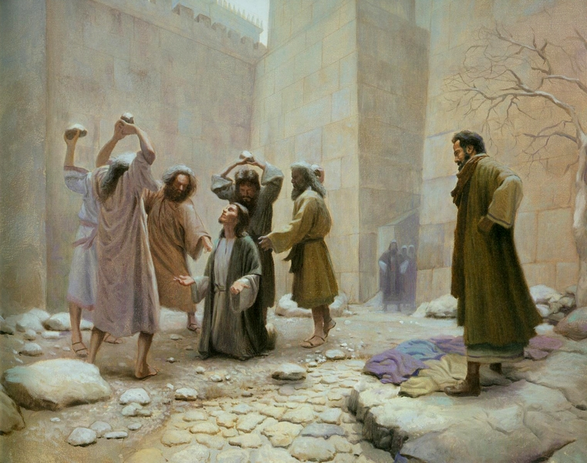
Paul approved of Stephen's Stoning
Acts 7:58; 8:1
Notes:
God used Stephen’s death to spread the kingdom northward (6:8–8:3).

Slide 40
Slides on Acts 8
Notes:
God used Philip to reach a sorcerer and Ethiopian official northward (8:4-40).

Slide 41
God's Plan: The church didn't follow…
Acts 1:8
so God caused…
Acts 8:1
"remotest part"
"But you shall receive power when the Holy Spirit has come upon you; and you shall be My witnesses both in Jerusalem, and in all Judea and Samaria, and even to the remotest part of the earth."
"Saul was one of the witnesses, and he agreed completely with the killing of Stephen. A great wave of persecution began that day, sweeping over the church in Jerusalem; and all the believers except the apostles were scattered through the regions of Judea and Samaria."
Samaria
Jerusalem
Judea

Slide 42
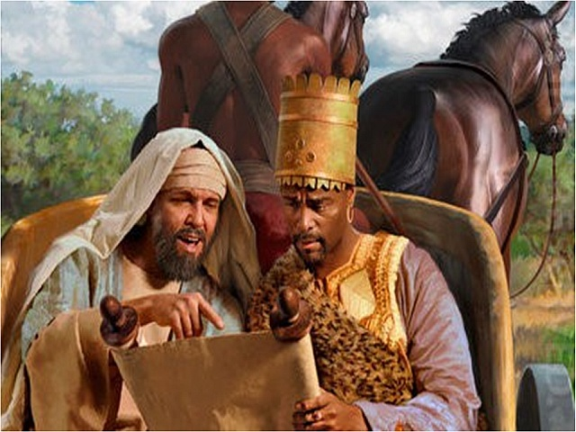
Philip witnessed to an Ethiopian Eunuch
Acts 8:26-40

Slide 43
Do you see how God has directed you through difficulty?
Notes:
Perhaps he used struggles elsewhere to bring you here outside the familiar (I feel like a stranger everywhere).
God worked in me in Singapore where I my comfort zone became comfortable.

Slide 44
Why should we be witnessing?
3 reasons
Notes:
What reasons are there for you and I to seek a harvest?
Why is evangelism important?

Slide 45
I. God has gone ahead of us so we can begin where we are (1:1–6:7).
Notes:
God helps us first tell others about Jesus where it is natural without crossing cultures.

Slide 46
II. God gets the glory when we witness outside our comfort zone (6:8–8:40).
Notes:
God is honored when we share about him with those who are not familiar.

Slide 47
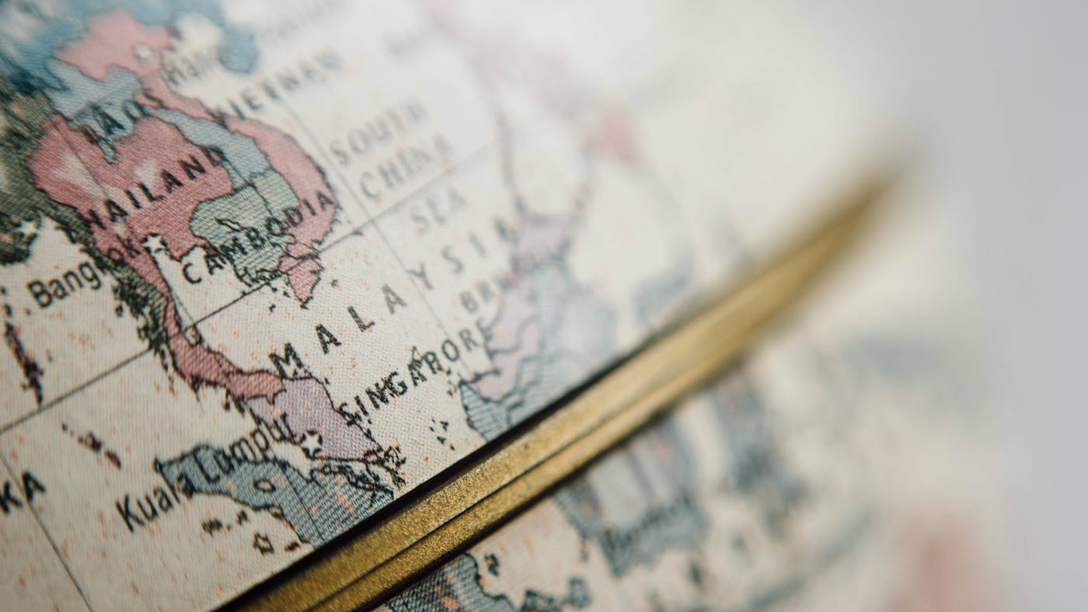
III. God will use us to spread the kingdom to the last unreached place (Acts 9–28).
Notes:
He promises that we will eventually witness in the final unevangelized place on earth.

Slide 48
Slides on Acts 9
Notes:
God saved Paul to reach Damascus of Syria (9:1-31).

Slide 49
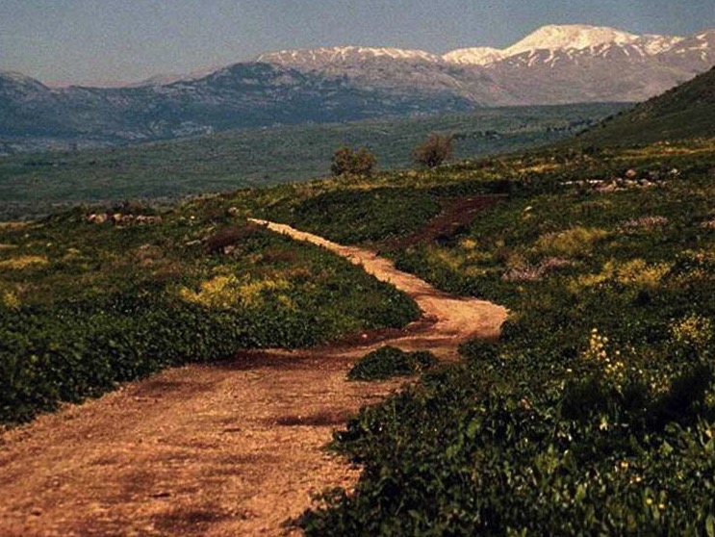
The Road to Damascus
Where Paul trusted Christ (Acts 9)

Slide 50
God preserved the Church from division despite new Gentile believers (Acts 9:32–12:24).

Slide 51
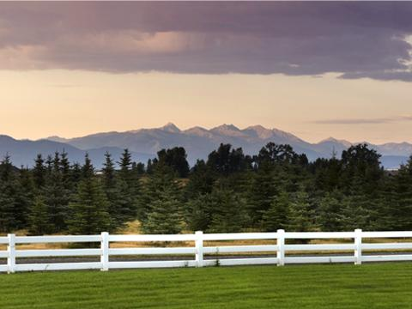
God prepared the Jewish church to include Gentiles (9:32–10:16).

Slide 52
Three Waves of Change...
God prepared Peter
God prepared Cornelius
God prepared Peter further
Notes:
God involved Peter in Cornelius's conversion to confirm to the Jewish church that God was doing a new thing (10:17-44).

Slide 53
Peter Prep: Step 1
Ministry to Samaritans (9:32-42)
Notes:
Before the big leap to Gentile ministry, God wisely had Peter first serve the half-breed Samaritans.

Slide 54
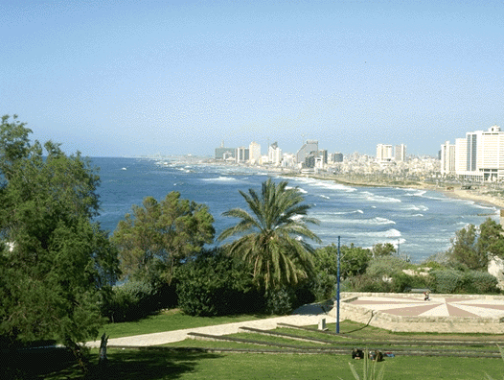
Peter Prep: Step 2
Peter Prep: Step 2
Life with the tanner (9:43)
Joppa
Notes:
Peter also lived with Simon the tanner—a Jew continuously unclean—as another step towards Gentile ministry.

Slide 55
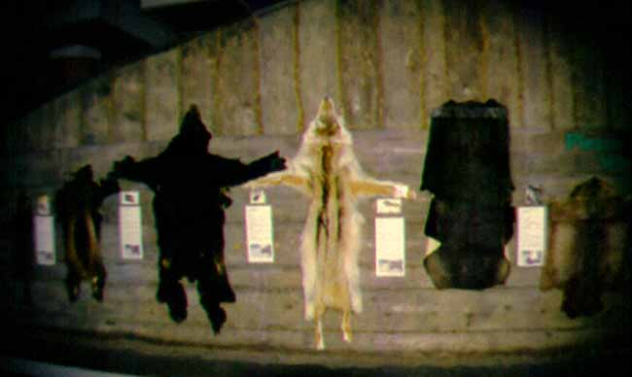
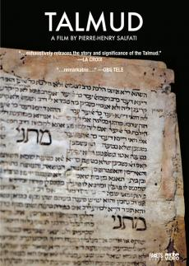
"Woe to him who is a tanner by trade"
The Jewish Babylonian Talmud

Slide 56
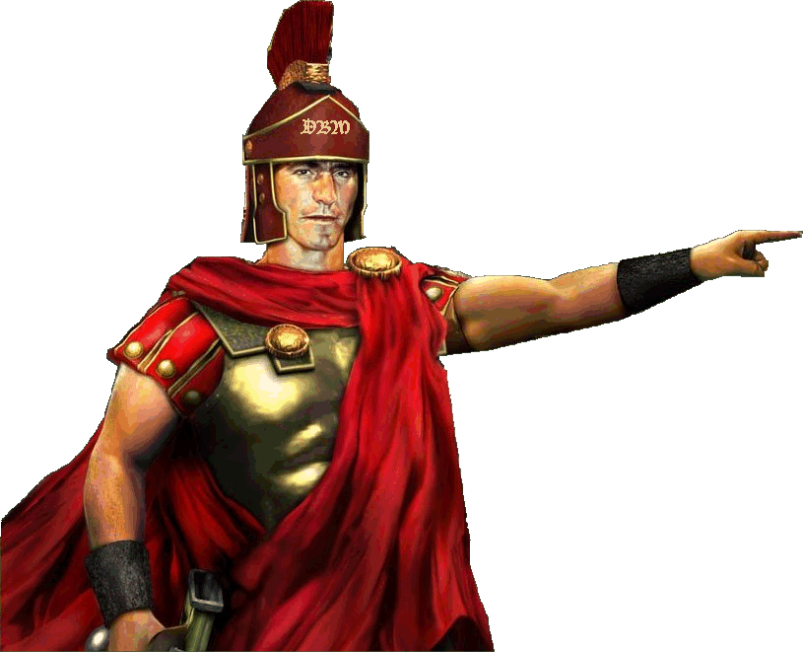
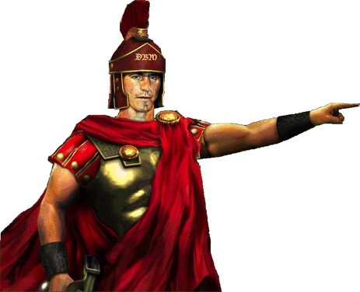
Cornelius Prep (10:1-8)
Alms & prayers
Vision

Slide 57
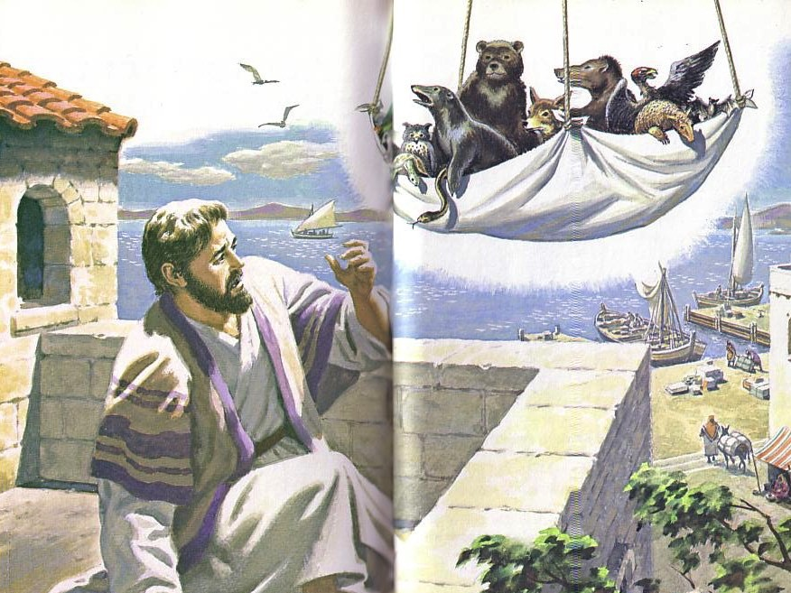
"Get up, Peter! Kill and eat!"
Peter Prep: Step 3
Eat "unclean" food (10:9-16)
The sheet "contained all kinds of four-footed animals, as well as reptiles of the earth and birds of the air" (10:12)
Notes:
Peter also learned that God was abolishing the OT “unclean” food laws—and thus he also was about to accept “unclean” Gentiles into the new faith, starting with Cornelius, who readlily trusted Christ.

Slide 58
Slides on Acts 11

Slide 59
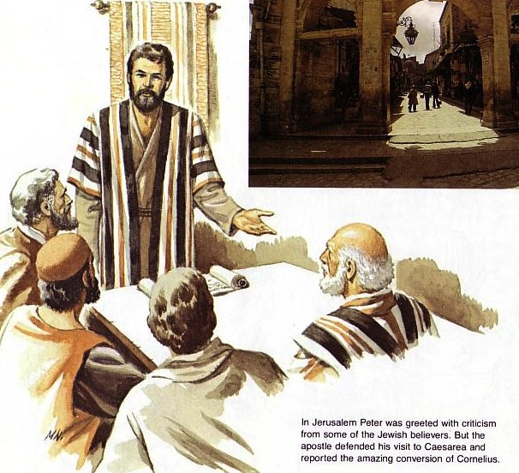
The Jerusalem church had to accept Gentile conversion because this change was from God (10:45–11:18)
Peter defends his lack of prejudice
Notes:
Meanwhile, the church at Antioch had the marks of a healthy international church (11:19-30).

Slide 60
Slides on Acts 12
Notes:
God responded to Jewish rejection of Christ by judging Herod and prospering the church (12:1-24).

Slide 61
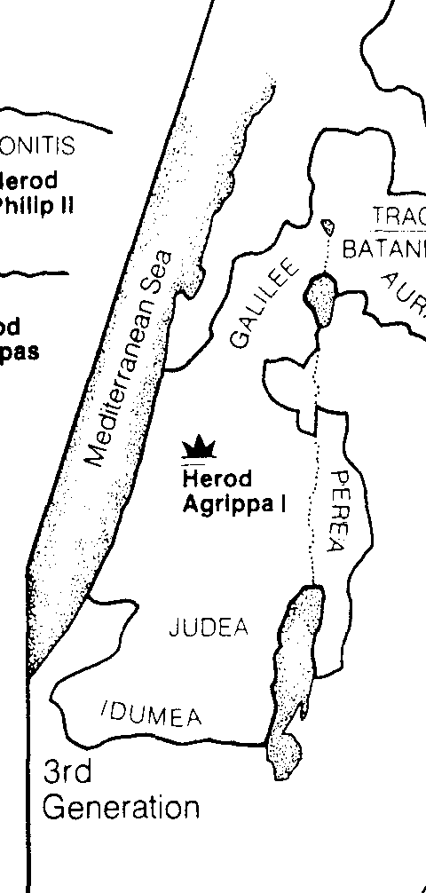
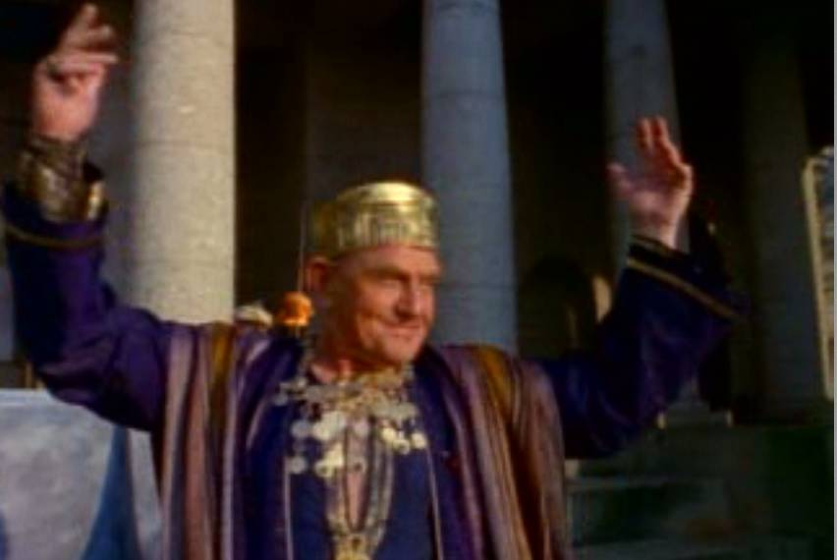
Herod's Grandson, Agrippa I (AD 37-44), was eaten by worms (Acts 12:23)
129
Bible Visual Resource Book, 181

Slide 62
Slides on Acts 13
Notes:
God expanded the Church in journeys to Turkey and Jerusalem approved (12:25–16:5).

Slide 63
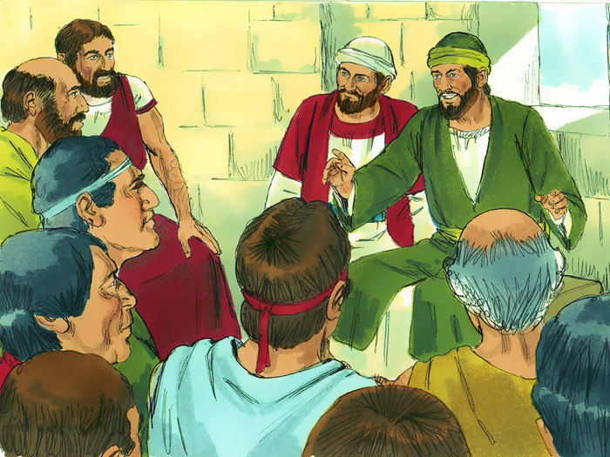
Early Prophets & Teachers
"Among the prophets and teachers of the church at Antioch of Syria were Barnabas, Simeon (called 'the black man'), Lucius (from Cyrene), Manaen (the childhood companion of King Herod Antipas), and Saul" (13:1 NLT).

Slide 64
Slides on Acts 14
Notes:
The first missionary journey of Paul and Barnabas extended the kingdom message to Cyprus and Galatia (12:25–14:28).

Slide 65
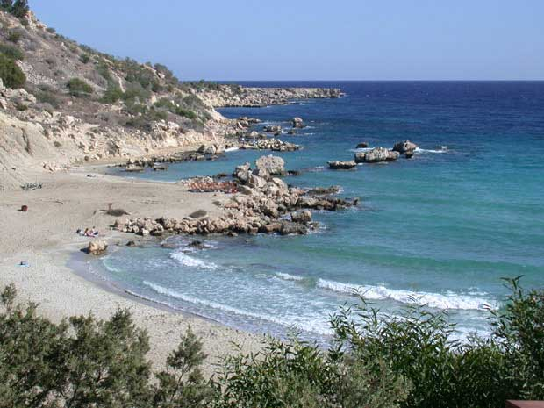
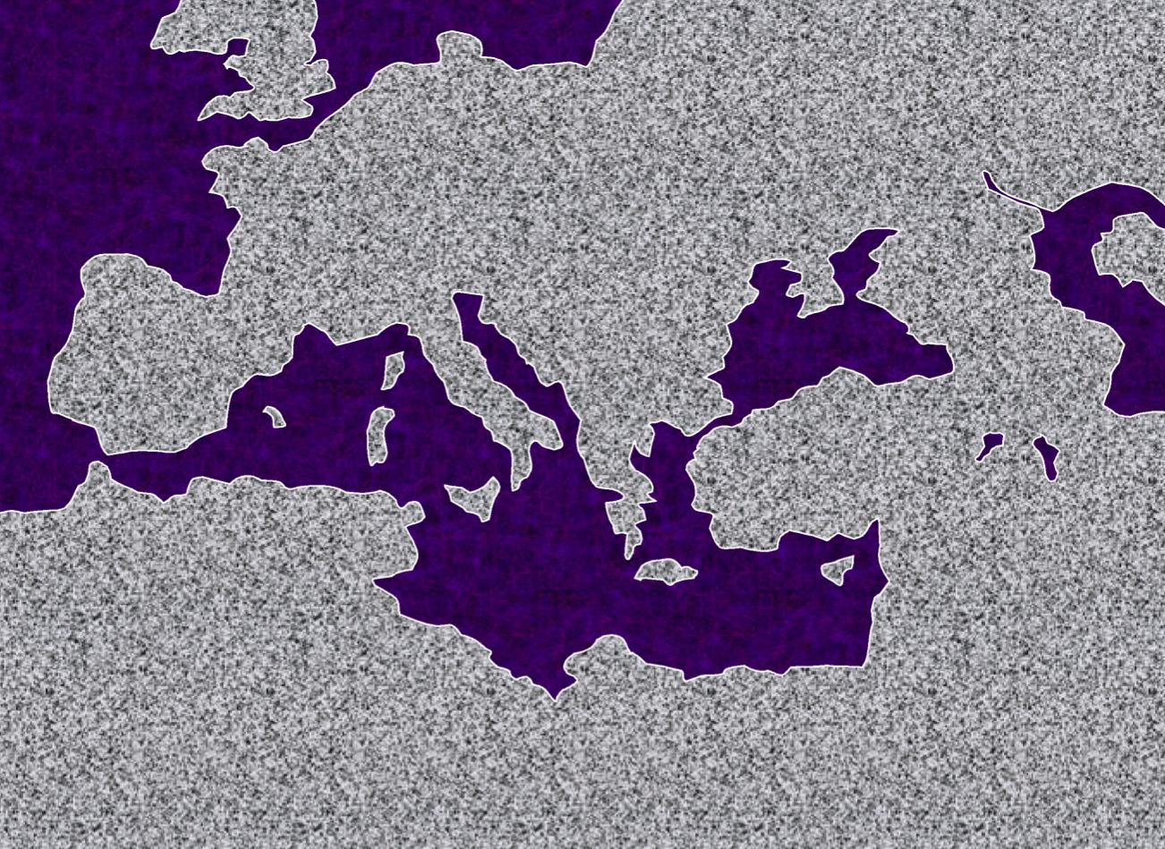
#1."The Hook: A Laboratory"
STUDY HELP #24
PAUL'S JOURNEYS …AT A GLANCE
ATLANTIC OCEAN
A.D. 48-49
EUROPE
A BEACH ON CYPRUS
ASIA
ROME•
Macedonia
•
•Pisidian Antioch
AFRICA
Athens
•Ephesus
Acts 13-14
•Syrian Antioch
MEDITERRANEAN SEA
•Jerusalem
Significance: Worshipped as gods; did miracles; Paul stoned; difficult work; churches planted; return by same route.
ARABIA
42
14
© 2006 TBBMI
9.65.08.
Notes:
With these ideas in mind…and with Study Help #24…let's go with Paul on his JOURNEYS AT A GLANCE. First…the main locations of the dramatic action facing Paul and his little party…
//// Here is Jerusalem…
//// SYRIAN Antioch…
//// PISIDIAN Antioch…(there were many ancient Antiochs!)…
//// Ephesus…
//// Macedonia…(Remember Alexander's birthplace?)…
//// Athens…
//// and the capital city of the world of his day…ROME, at the center of Empire.
//// So…Trip #1: Call it the HOOK…or A LABORATORY on Study Help #24…
//// Recounted in some detail in Acts 13 and 14.
//// Here's a Cyprian beach typical of those Paul and his party would have moved across.
//// On your map trace out his route similar to A HOOK SHAPE that moves from SYRIAN ANTIOCH through the island of Cyprus and on into central Turkey.
//// Significance of this trip: IT WAS A LEARNING LABORATORY! No one had done this before. Along the way they were worshipped as GODS…because the people had never seen anything like this…these strangers were going about working miracles. But in spite of those good works, Paul was STONED and almost died. The party must have quickly recognized that mission would become a very difficult work indeed. But along the way many new churches were planted. What kept them going? Faith in all they had seen and experienced in the development of their own Christian spirit and intellect. Their travel route began at Syrian Antioch – follow your hook – into today's central Turkey…
//// …then they turned around and returned to Syrian Antioch by the same route, there to report the results of their journey to the church.
//// LENGTH OF THIS TRIP: PROBABLY ABOUT 1.5 YEARS
IN THE LAST HALF OF THE A.D. 40s.

Slide 66
Slides on Acts 15

Slide 67
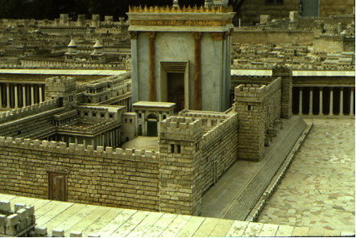
1(--)2"The Jerusalem Council"
A.D.49
Acts 15:1—Must a Gentile become a Jew, and accept his laws and ceremonies, before he can become a Christian?
ATLANTIC OCEAN
EUROPE
GRACE ONLY!
ASIA
ROME•
•Macedonia
•Pisidian Antioch
Athens
•Ephesus
AFRICA
Acts 15
•Syrian Antioch
MEDITERRANEAN SEA
1(--)2 "The Jerusalem Council"
•Jerusalem
The issue was permanently settled: GRACE, not LAW!
ARABIA
© 2006 TBBMI
9.65.08.
43
4
Notes:
Paul apparently had little time to rest up.
//// In Fall A.D. 49 he made that special SHORT trip between the BIG TRIPS #1 and #2…for the famous JERUSALEM COUNCIL.
This was a 500-mile journey from Syrian Antioch, south to the city of the mother church…to Jerusalem.
//// The issue here –– told to us in Acts 15 –– was the simple question:
"Must a Gentile become a Jew, and accept his laws and ceremonies, before he can become a Christian?" It must have been a heated argument!
//// Finally the issue was permanently settled: one becomes a Christian through GRACE…not LAW. However, if following the law makes one comfortable, fine. Accepting Christ as Lord and Savior is a matter of belief and relinquishment –– that is the only requirement! GRACE AND GRACE ONLY!
//// Then Paul and his party returned north to Syrian Antioch. Our BASIC BELIEFS of today date firmly from that Jerusalem meeting of Acts 15. Later reformers of the church also anchored their Christian tenets right there – dating from the Jerusalem Council.

Slide 68
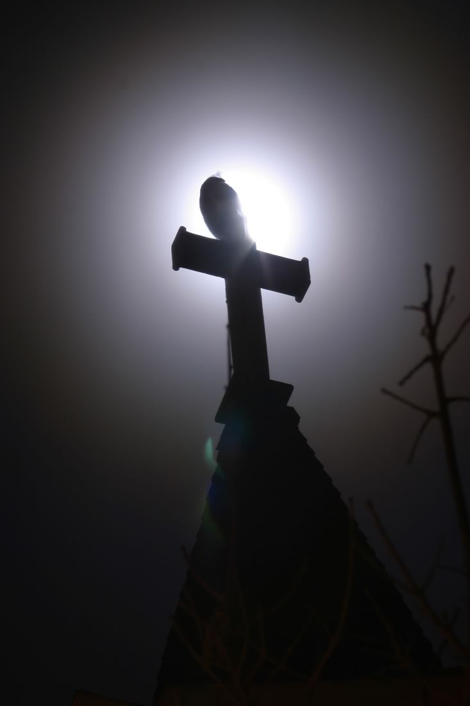
Key Decisions in Acts 15
Ecclesiology 86-87
Circumcision at the Jerusalem Council (vv. 1-35)
Conflict over John Mark's Restoration (vv. 36-40)
Notes:
The Jerusalem Council decision not to require the Law for Gentiles was directed by God to expand the kingdom message through the Roman Empire (15:1-35).

Slide 69
Slides on Acts 16
Notes:
God extended the Church to the Aegean after keeping Paul from Asia (16:6–19:20).

Slide 70
Macedonia
Bithynia
Troas
Paul & Silas
During the night Paul had a vision of a man of Macedonia standing and begging him,
Asia
Come over and help us!
Antioch
Jerusalem
2nd Missionary Journey
Part 2: Macedonian Mission
(Acts 16:11–18:22)
Notes:
After Phrygia and Galatia, Paul was kept from Asia and Bithynia by the Spirit but called to Macedonia as God planned for the gospel to reach Europe (16:6-10).

Slide 71
God reveals himself
to those who seek
and worship him (Acts 16)
Lydia
Slave Girl
Jailer
through Paul and others called to minister (16:11-15)
not through the testimony of demons (16:16-23)
through actions of his disciples (16:24-40)

Slide 72
Slides on Acts 17

Slide 73
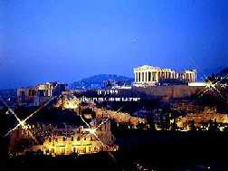
2. "The European Thrust"
ATLANTIC OCEAN
A.D. 49-52
EUROPE
ANCIENT ATHENS
ASIA
ROME•
•Macedonia
•Pisidian Antioch
•
•Ephesus
AFRICA
Athens
Acts 15-18
•Syrian Antioch
MEDITERRANEAN SEA
2."The European Thrust"
•Jerusalem
Significance: many church plants; call to Macedonia, on to Athens, "the unknown god"; Mars Hill; lengthy Corinthian stay.
ARABIA
44
5
©2006 TBBMI
9.65.08.
© 2006 TBBMI
Notes:
Paul then began to prepare for extended missionary trips.
//// Trip #2…THE EUROPEAN THRUST…is recalled in detail in Acts 15 through 18.
//// This second journey began overland from Syrian Antioch…all the way into Greece…then returning by sea to make his report to the church in Jerusalem…then back home to Syrian Antioch.
//// There were church plants along the way… They met in synagogues every Sabbath…speaking either Greek –– thanks to Alexander the Great –– or Hebrew or Latin. Paul spoke all those languages. This is the time of that famous call to "come over to MACEDONIA and help us." And then he took up a lengthy residence in the wild, seaside town of CORINTH, only a short journey from Athens.
//// On this trip he debated with the Athenian philosophers on Mars Hill, recognizing their statue to "the unknown God." He built a sermon around that!
//// LENGTH OF THIS TRIP: ESTIMATED AT ABOUT TWO AND A HALF YEARS BETWEEN A.D. 49 AND 52.

Slide 74
Slides on Acts 18
Notes:
The second missionary journey became the third as God led Paul and assistants to extend the church into Macedonia, Achaia, and Ephesus (16:11–19:20).

Slide 75
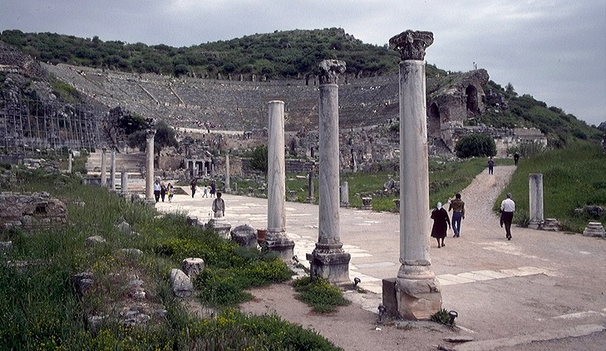
3."The Asian Thrust"
A.D. 53-57
ATLANTIC OCEAN
EUROPE
ANCIENT EPHESUS
ROME•
•Macedonia
ASIA
•Pisidian Antioch
•
•Ephesus
AFRICA
Athens
Acts 18-21
•Syrian Antioch
MEDITERRANEAN SEA
3.”The Asian Thrust”
•Jerusalem
Significance: extended time at the church in Ephesus; young man raised from the dead; important letters written; riot with Ephesian artisans at amphitheatre.
ARABIA
9.65.08.
45
4
© 2006 TBBMI
9.65.08.
Notes:
Then came Paul's ASIAN THRUST…recorded in Acts 18-21.
//// Again, this trip began overland from Syrian Antioch…revisited many of the earlier churches…made a horseshoe-shaped route around the Aegean, back down into Greece, retraced that route back around the horseshoe, remaining at Troas, then returning by sea to Syrian Antioch.
//// Paul spent a very long time living and ministering to the church the EPHESUS. Luke reports that Paul raised a young man from the dead in Ephesus. Many important letters –– our Epistles –– were written from Ephesus.
//// One of the most dramatic events recorded for us took place at the Ephesian AMPHITHEATRE where he confronted the souvenir makers of the city…those who manufactured small idols of the Goddess Diana, whose temple in Ephesus was one of the seven wonders of the ancient world.
//// LENGTH OF THIS TRIP: ALMOST FIVE YEARS BETWEEN A.D. 53 AND 57.

Slide 76
Slides on Acts 19
Notes:
Beginning in Acts 19, God extended the kingdom message to Roman rulers even in Rome itself (19:21–28:31).

Slide 77
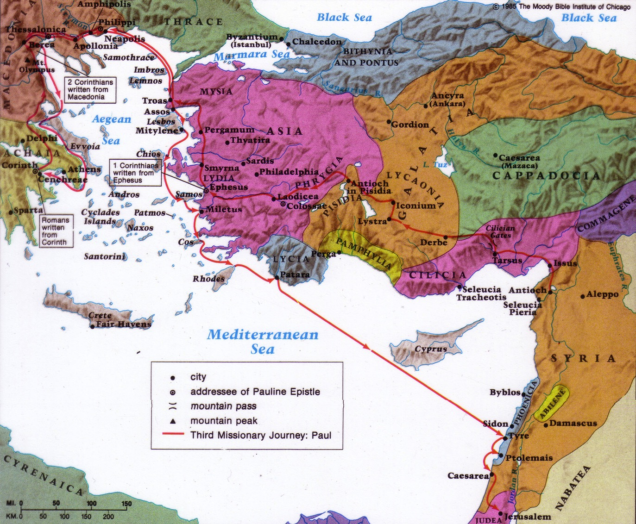
Paul's Third Missionary Journey
140
EPHESUS
Paul taught in Ephesus "for two years, so that all of Asia heard the word of the Lord" (Acts 19:10)
Notes:
Paul’s third journey had Luke and started no new churches but strengthened Aegean area believers, especially in Ephesus, until it ended in Jerusalem (19:21–21:16).

Slide 78
Slides on Acts 24
Notes:
Paul's journey to Rome had three captivities where God extended the kingdom message to rulers in Rome as a sending base to the end of the world (21:17–28:31).

Slide 79
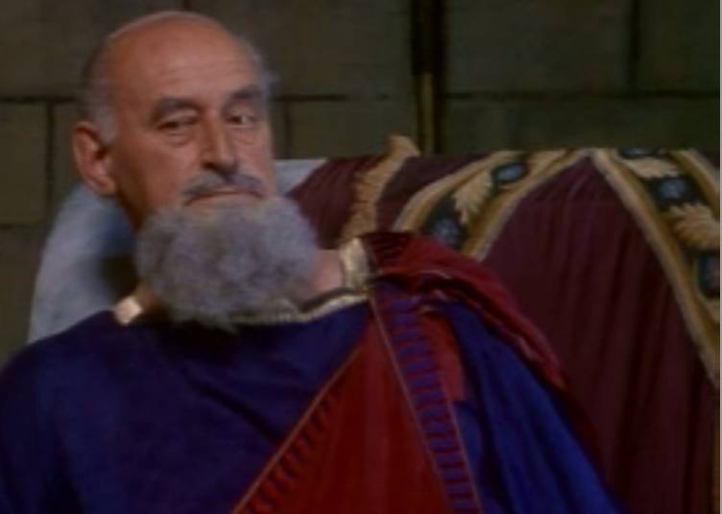
Felix (AD 52-59) tried Paul in Caesarea, imprisoning him from AD 57-59 (Acts 24). Felix did not find Paul guilty but still confined him.
129

Slide 80
Slides on Acts 25

Slide 81
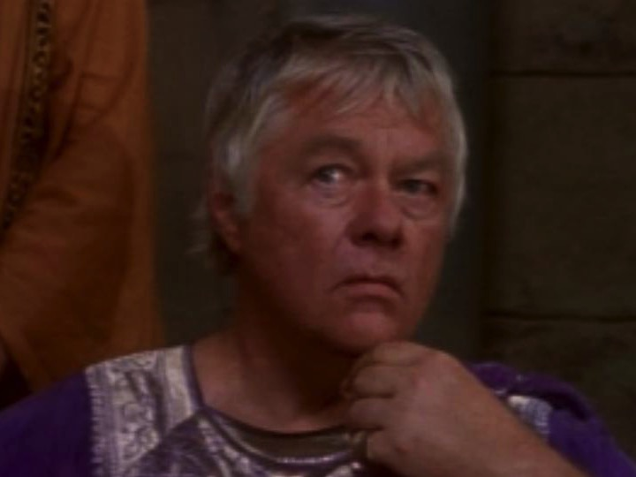
Porcius Festus also tried Paul and found him innocent (Acts 25)
129

Slide 82
Slides on Acts 26

Slide 83
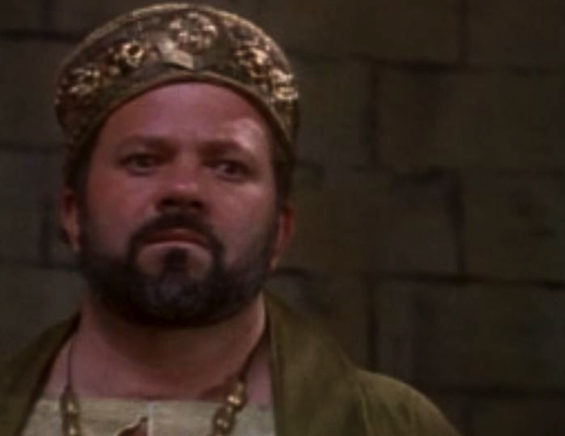
Herod's Great Grandson, King Agrippa II, also found Paul innocent (Acts 26:31)
129
Bible Visual Resource Book, 181

Slide 84
Slides on Acts 28

Slide 85
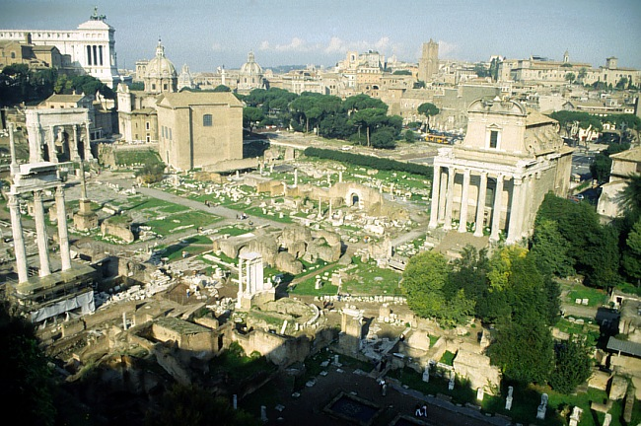
4. "To Rome and GAIN!"
A.D. 59-62
ATLANTIC OCEAN
EUROPE
ASIA
ROME•
ROME'S ANCIENT FORUM
•Macedonia
•Pisidian Antioch
•
•Ephesus
AFRICA
Athens
Acts 21-28
•Syrian Antioch
MEDITERRANEAN SEA
4."To Rome and GAIN!"
•Jerusalem
ARABIA
Significance: As a prisoner, sent to Rome; Christian influence in prison and the house of Caesar; important later letters; 5 years later "fought the good fight, kept the faith!"
9.65.08.
46
3
© 2006 TBBMI
9.65.08.
Notes:
Finally…Trip Number 4…Acts 21-28…"To Rome and Gain"…. describes Paul's final journey: Remember that Paul once wrote that for him to live was Christ…and to die would be his eternally great gain!
//// On this journey, he left an Roman prison in Caesarea –– on the Israeli coast –– boarding a Roman grain ship, then by sea to Italy with frequent stops along the way, landing at a small town near today's Naples, finally traveling on foot with friends to his imprisonment in Rome.
//// As a prisoner of ROME he was sent there for trial. But even in Rome, while in rented quarters (Acts 20:28-29), his passionate missionary spirit brought the Gospel into that house and from there into the very household of CAESAR. In prison he wrote four important letters. Some scholars believe he made an additional trip to Spain, but that is not certain. Six years later from Rome during his second imprisonment he gave the anthem for the well-lived life: "I have fought the good fight, I have kept the faith!" (2 Tim. 4:7).
//// LENGTH OF THE TRIP AND STAY IN ROME UNTIL HIS DEATH…ABOUT FOUR YEARS…A.D. 59-62.
//// Study Help 36 gives a finished view of all of Paul's travels along with their approximate dates according to good scholarship.

Slide 86
Gospel Progress
124
The progress of the gospel in Acts is seen by contrasting the beginning and the end:
Acts 1
Acts 28
AD
33
62
Church
Non-existent
Thriving
Composition of believers
100% Jewish
Mostly Gentiles
Location
Jerusalem
Rome
Central Figure
Peter
(narrow ministry)
Paul
(broad ministry)

Slide 87
Notes:
Our vision is to pursue God, pursue others, and practice His ways to the end of the age.

Slide 88
Asia Teaching 1991-2021
MONGOLIA
JORDAN
KOREA
CHINA
NEPAL
MYANMAR
INDIA
THAILAND
VIETNAM
MALAYSIA
SRI LANKA
SINGAPORE
SINGAPORE BIBLE COLLEGE
INDONESIA
Notes:
For 30 years, God has seen fit to grant me the privilege to train pastors in 12 other countries on 73 trips. Often pastors in the US team-teach with me on these trips. To help the poor, I avoid the wealthy countries where listeners can pay an honorarium but instead raise the funds to pay my own way and then teach for free.

Slide 89
From East to West
Spain
? years
Eastern Empire
30 years
MENA
? years
East Asia
30 years
Notes:
As Paul ministered in the East for 30 years and then turned his sights westward for a few years, so God has done for us. Our 30 years in East Asia has transitioned into our remaining ministry years in MENA.

Slide 90
Jordan Evangelical Theological Seminary (JETS)
Notes:
The school has its 30th anniversary this year.

Slide 91
JETS (bachelor to doctoral)
Whitman Academy
(K-12)
Notes:
JETS shares its campus with Whitman Academy, the key Christian international school in Jordan.

Slide 92
Faculty
25 Faculty
25 Doctorates
15 Faculty
4 Doctorates
Notes:
We will be witnesses as long as we exist—but we need to be more strategic, so God is moving us from Asia to MENA (Middle East/North Africa) to teach Arabs at JETS (Jordan Evangelical Theological Seminary) as it has greater faculty needs.

Slide 93
"From every tribe, nation, language and people" (Rev. 5:9)
Notes:
We will ultimately succeed in the task of being his witnesses (Matt 24:14; Rev 5:9; 7:9).

Slide 94
Why should we be witnessing?
In order to…
Notes:
What reasons are there for you and I to seek a harvest?
Why is evangelism important?
Why witness everywhere? To…

Slide 95
Main Idea of the Book
Be part of God’s plan to bring the kingdom message to all people.
Acts
Notes:
Jesus said that his disciples WOULD be his witnesses to the uttermost part, so the issue for us is whether we will resist Jesus or join with Jesus in his sure strategy to bring the gospel to that last unreached person.

Slide 96
What is your role in God’s plan that he started in early church history?

Slide 97
Witness in your Jerusalem: inside your comfort zone. Witness in your Judea and Samaria: outside your comfort zone. Witness to all the world: share until the uttermost part is reached.

Slide 99
Bible Exposition link at BibleStudyDownloads.org
Get this presentation and script for free!

